Slide 1
The Internet Of Things
Shan Ahmed Usmani

Slide 2
Definition
The IoT is defined by Wikipedia: https:/ / en.wikipedia.org/ wiki/ Internet_ of_ things as The Internet of things (IoT) is the inter-networking of physical devices, vehicles (also referred to as "connected devices" and "smart devices"), buildings, and other items embedded with electronics, software, sensors, actuators, and network connectivity which enable these objects to collect and exchange data.

Slide 3
The internet of things, or IoT, is a system of interrelated computing devices, mechanical and digital machines, objects, animals or people that are provided with unique identifiers (UIDs) and the ability to transfer data over a network without requiring human-to-human or human-to-computer interaction.
Internet of Things (IoT) is a system of devices connected to the Internet with the ability to collect and exchange data from users or environment with no human intervention

Slide 4
Things
The device or the ‘thing’ in IoT could be any device embedded with electronics, software and sensor like a smart refrigerator, a smart air conditioner, lights in household, connected security systems or even a person with a heart monitor or an automobile.

Slide 5
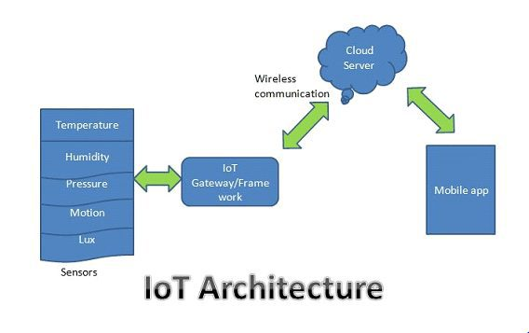
Basic Architecture

Slide 6
Why IoT ?
We are lazy
We want to automate everything
We want to control everything remotely
We want to see data in real-time

Slide 7
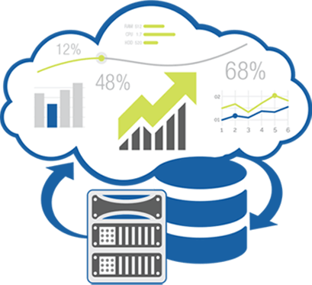
Four Pillars of IoT
Sensors &
Actuators
Processors/ Controllers Development Boards
Cloud &
Data Analytics
Network / Protocol
Internet of Things (IoT)

Slide 8
Sensors/ Actuators
“Sensors” are Transducers, which converts physical parameters (Temperature, Pressure, Humidity, Gas Concentration into Electrical parameters like Voltage/ Current.
Material property changes with change in physical parameters/ R-C Changes
Signal Conditioning Circuit
Voltage/ Current
Flow diagram how a Sensor,Senses Physical parameters and Convert it in-terms of Electrical parameters (Voltage/ Current)

Slide 9
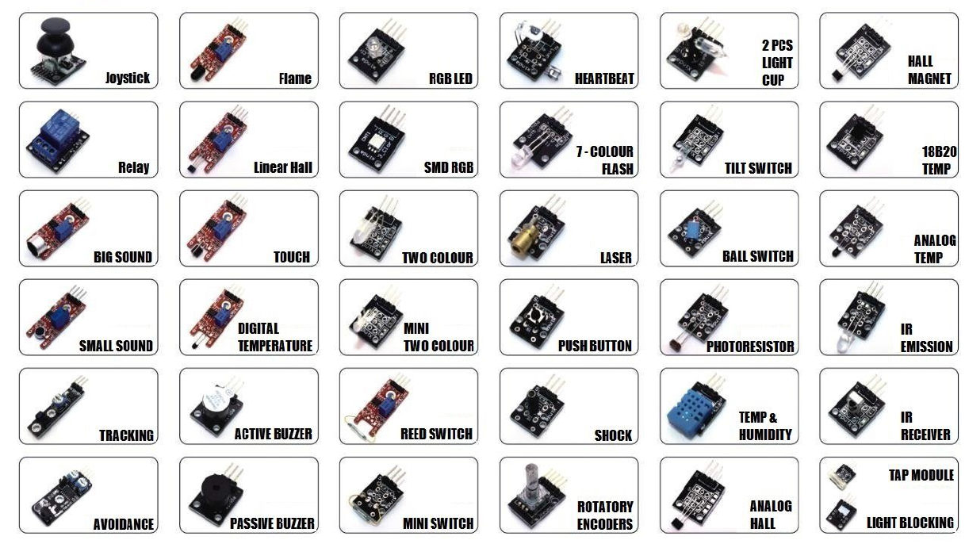
Major Sensors for IoT Application

Slide 10
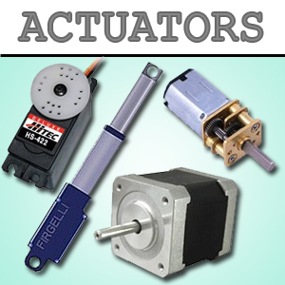
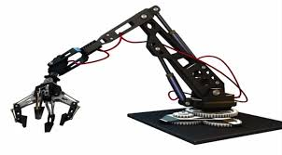
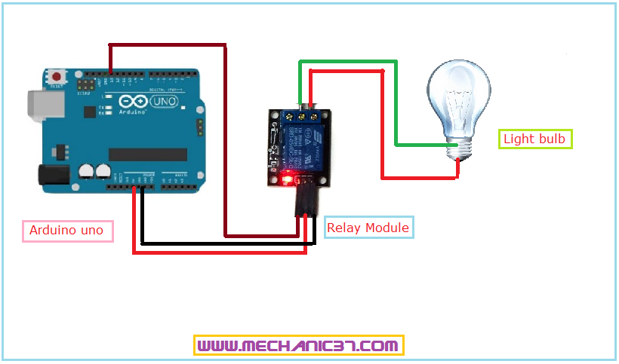
Actuators
An actuator is a component of a machine that is responsible for moving or controlling a mechanism or system. An actuator requires a control signal and a source of energy. The control signal is relatively low energy and may be electric voltage or current, pneumatic or hydraulic pressure, or even human power.

Slide 11
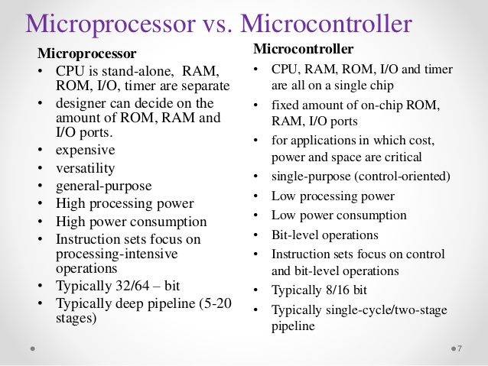
Processors/ Controllers Development Boards

Slide 12
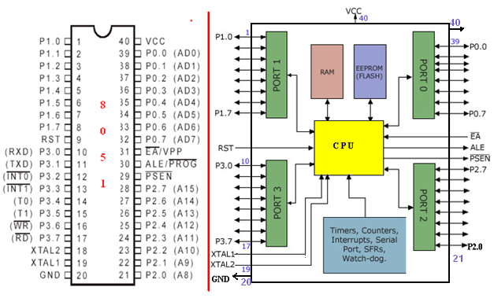
Processors/ Controllers Development Boards
Intel 8051 Microcontroller

Slide 13
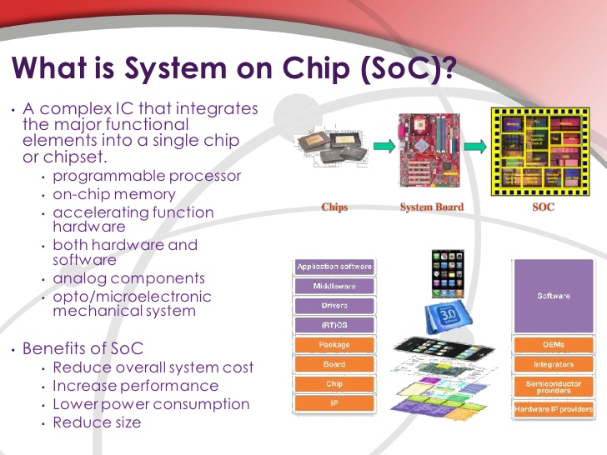
Processors/ Controllers Development Boards

Slide 14
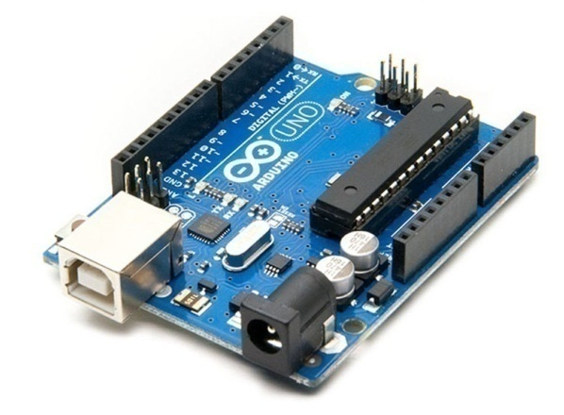
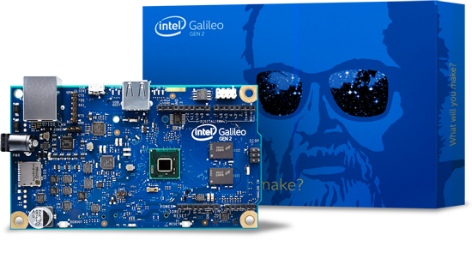
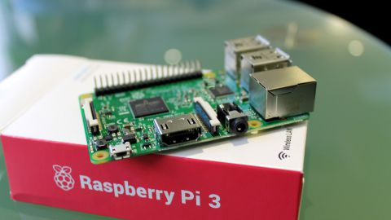
Processors/ Controllers Development Boards
Some Popular Dev. Platforms:
Development Platforms
Arduino
Raspberry Pi
&
Other Pi Series
Intel Galileo

Slide 15
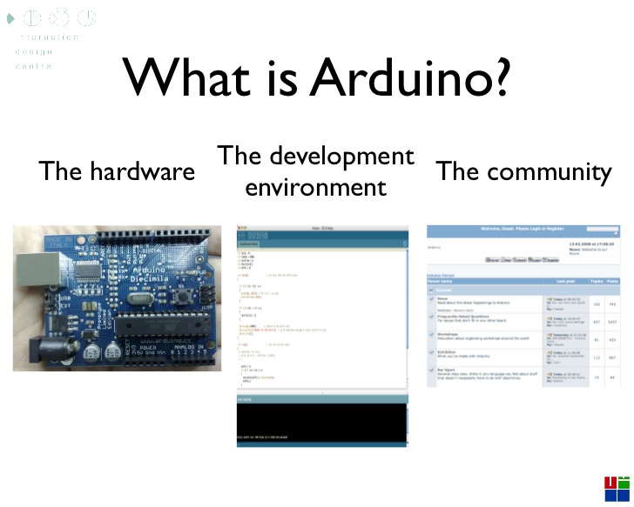
Development Platforms Arduino®

Slide 16
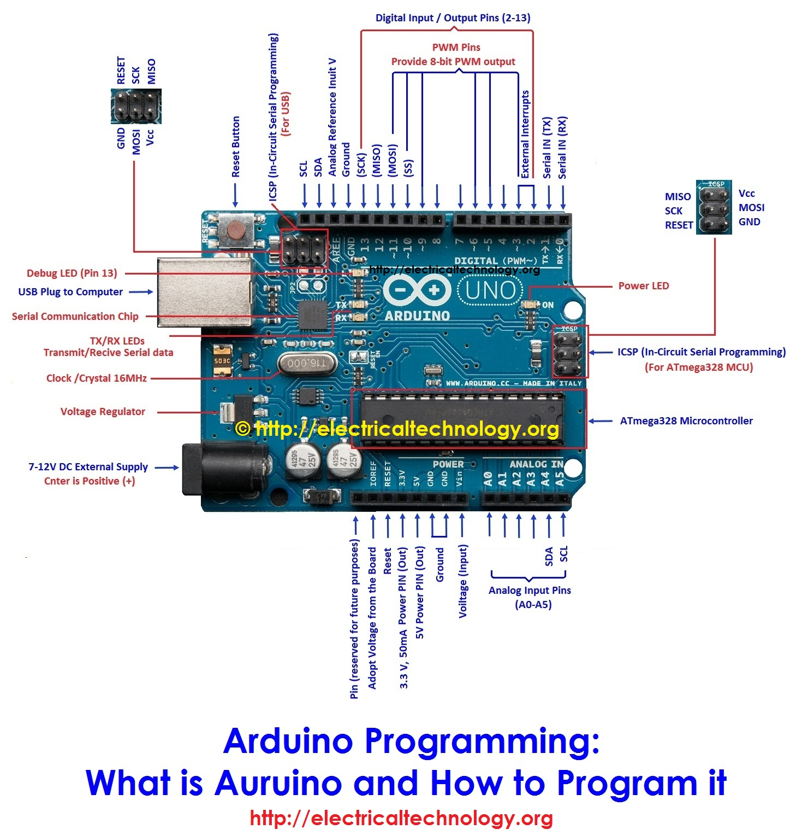
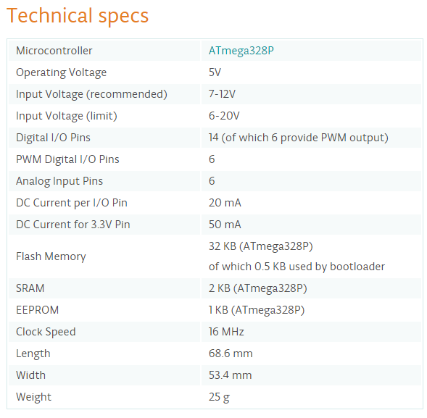
Development Platforms Arduino®

Slide 17
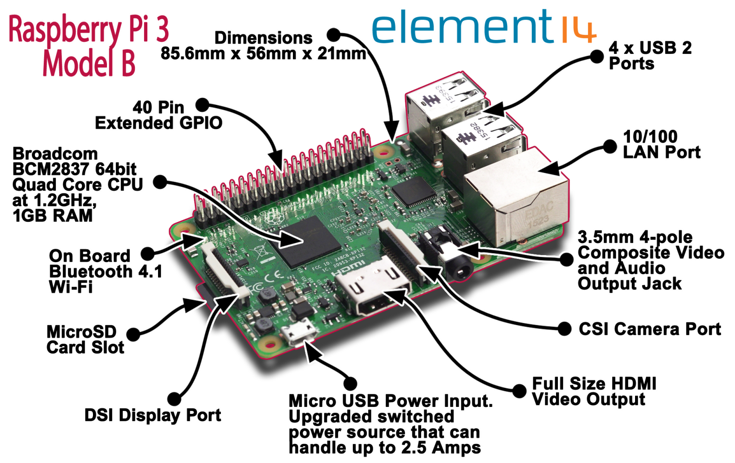
Development Platforms Raspberry Pi®
The Raspberry Pi is a credit-card-sized computer that plugs into your TV and a keyboard. It is a capable little computer which can be used in electronics projects, and for many of the things that your desktop PC does, like spreadsheets, word processing, browsing the internet, and playing games.

Slide 18
Communication
Ethernet
RS485
Wi-Fi
BLE
RF

Slide 19
Network Protocols
HTTP
MQTT
WebSocket

Slide 20
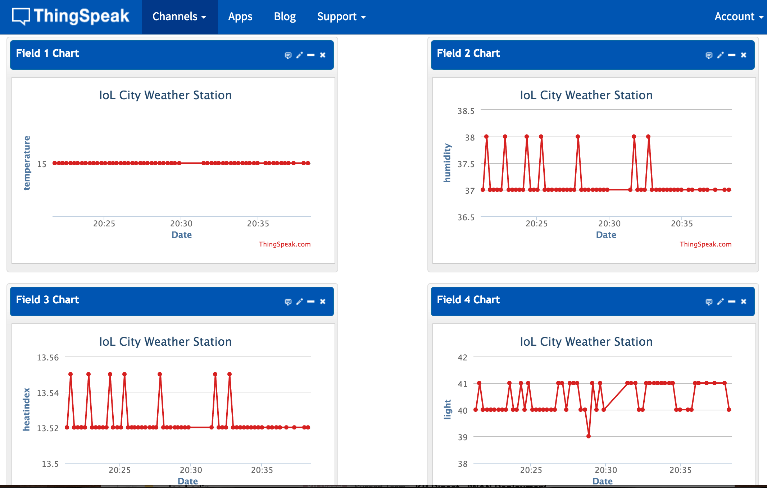
ThinkSpeak® Data Analytics

Slide 21
Things to Consider….
A Positive Reward: a 5x gain is the target and has worked well for the introduction of new technologies to pre-existing industries.
Scalability: IoT design is, by nature, a plurality of devices. The value of IoT is not a single device or a single location broadcasting data to a server. It's a set of things broadcasting information and understanding the value the information in aggregate is trying to tell you.

Slide 22
Thank You

